Slide 1
Analysis of Airline Data
Ist 687 - M004
Group -1

Slide 2
About data
South East Airlines 10282 rows 32 columns
14 Partner Airlines
Dependent Variable is Likelihood to recommend
3 type of travelers
4 Types Of Airlines status

Slide 3
Process
Data Munging
Exploratory Data Analysis
Visual Insights
Implementing Various Models
Visual Insights on the basis of model results
Data Driven Suggestions

Slide 4

DATA MUNGING
NA’s
Unused Columns
Numeric & Factorization
Our Data is Ready.

Slide 5
Business Questions :
How different Age groups affect Likelihood to Recommend.
Which Gender is more likely to be a Detractor/ Promoter.
How does Arrival Delay affect Likelihood to Recommend.
How does Price Sensitivity affect Likelihood to Recommend.
How does Type of travel affect Likelihood to Recommend.
Which Airline Status has maximum Detractors.
Why we have considered Fly-Fast Airways Inc. and Northwest Business Airlines.
On what basis we selected different variables.

Slide 6
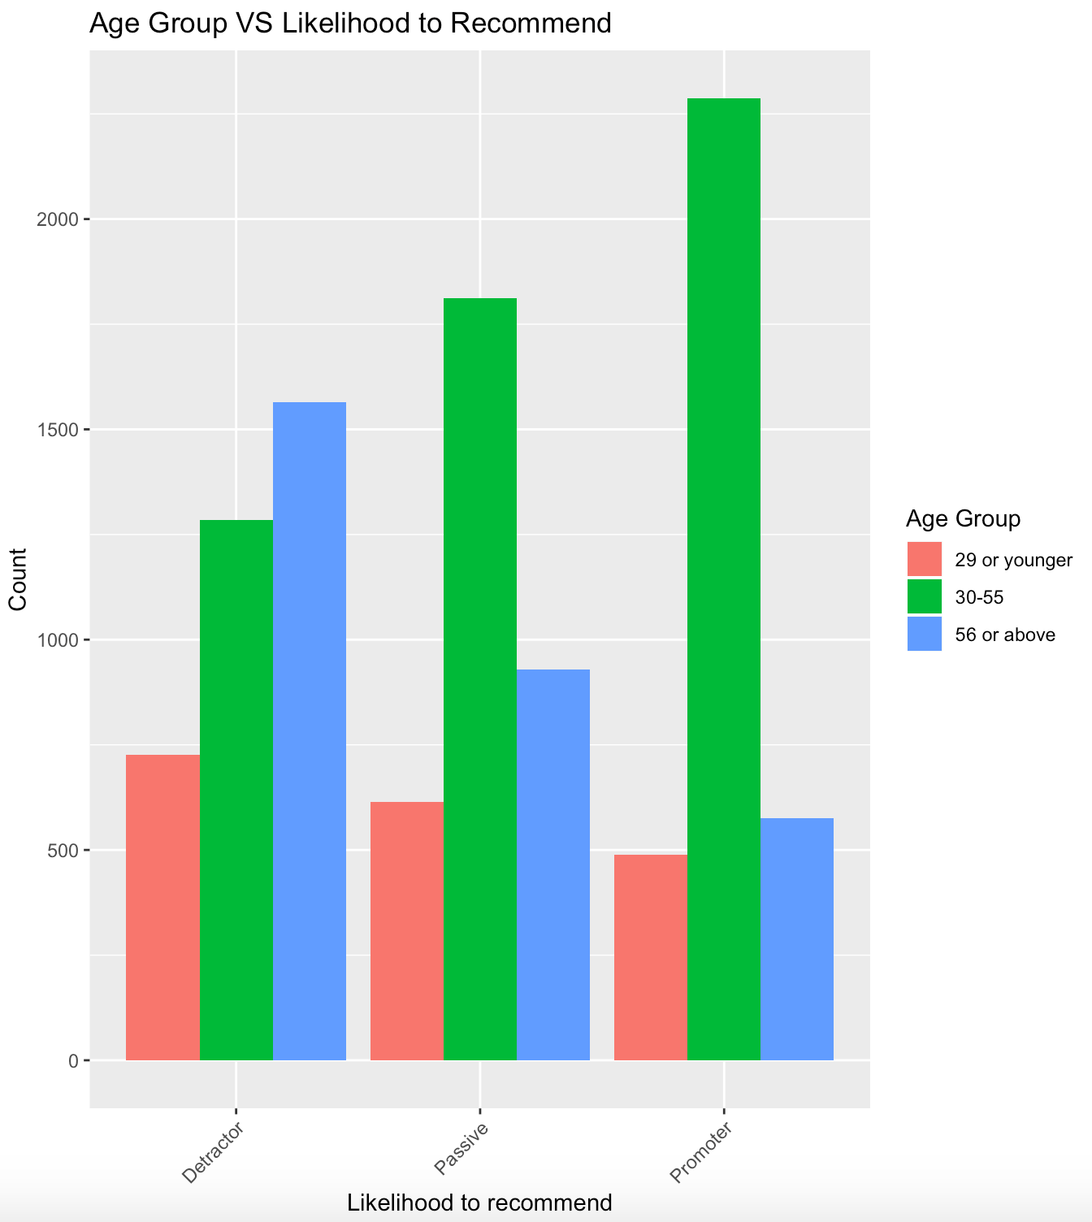
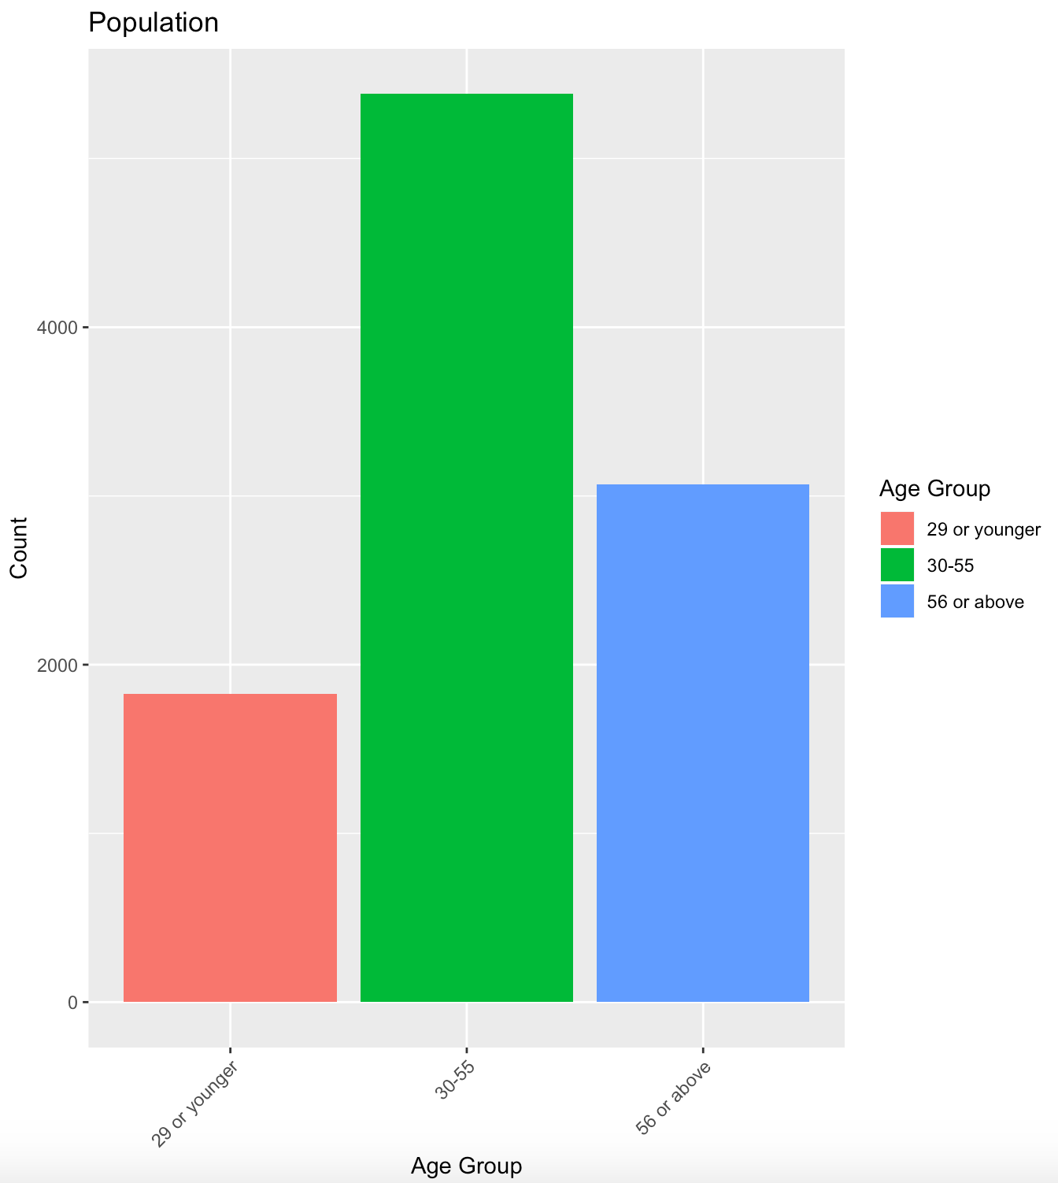
Age Groups vs Likelihood to Recommend
Notes:
First, we have divided people in to three age groups: 29 or younger, 30-55, and 56 or above. We have created Age group vs likelihood to recommend graph for you. From this graph, we can tell that in the promoter group, the people from 30 – 55 years old are more likely to be a promoter while people from 56 years old or above group are more likely to become a detractor.
However, when we look at the population from each group, we have discovered that the population from 30 – 55 years old is larger than any other groups. The younger group has 1829 people, the median age group has 5382 people, the older group has 3071 people. Hence, we decided to go further to investigate if this results still hold.

Slide 7
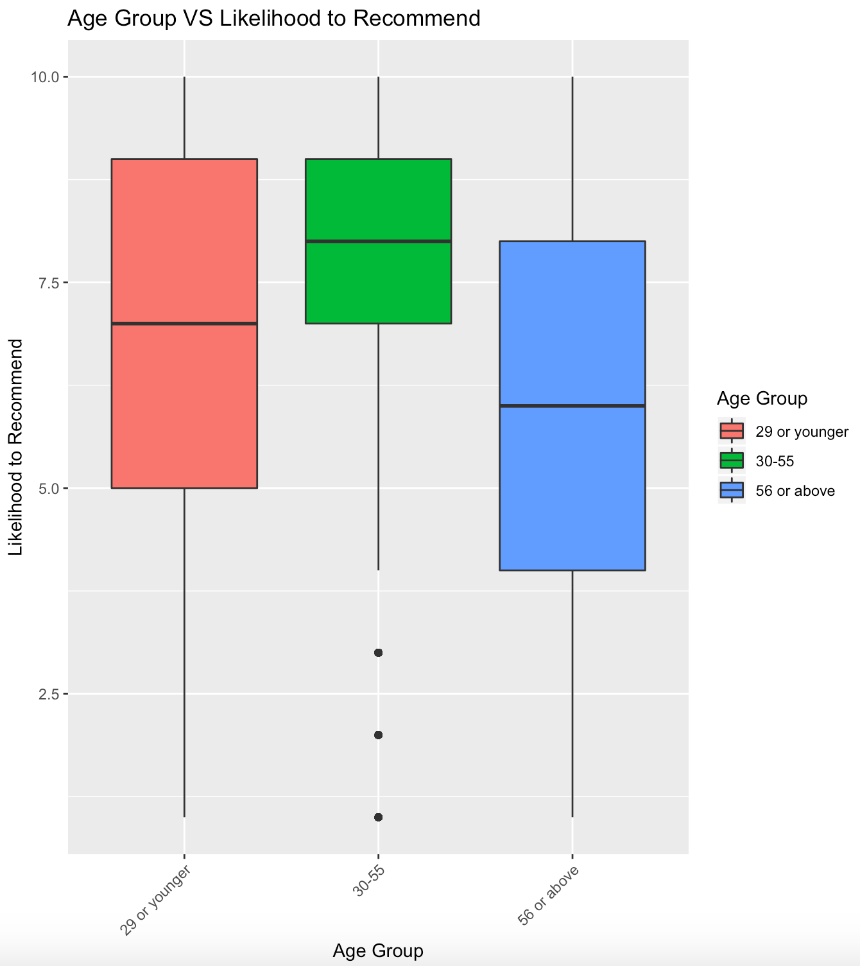
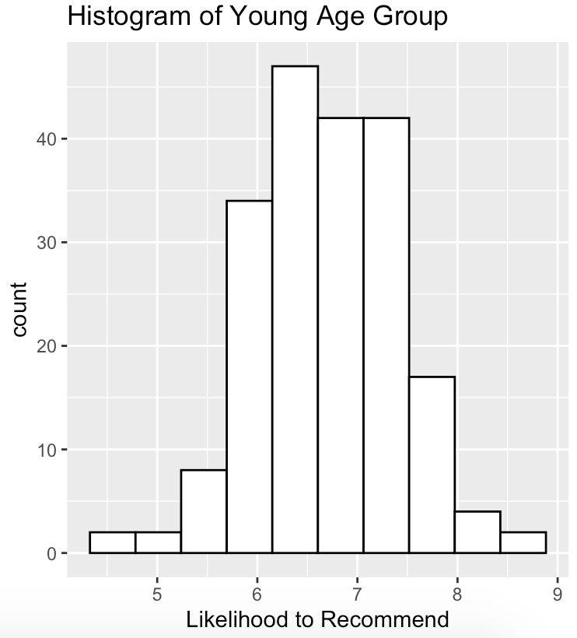
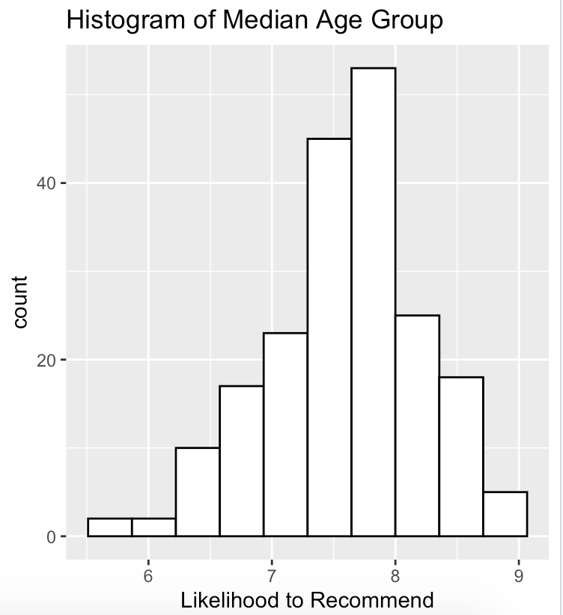
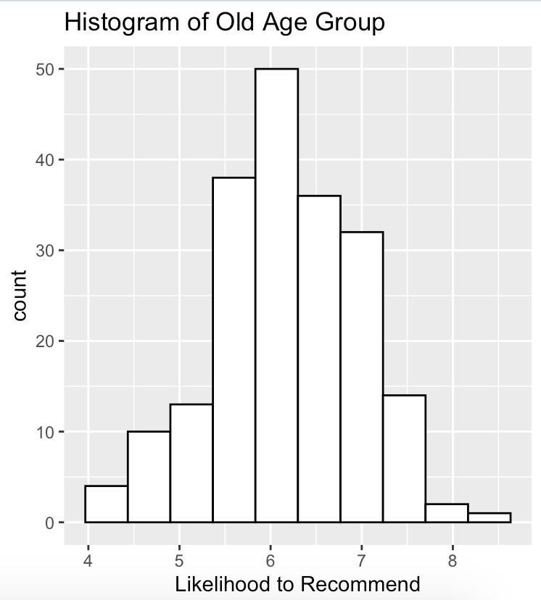
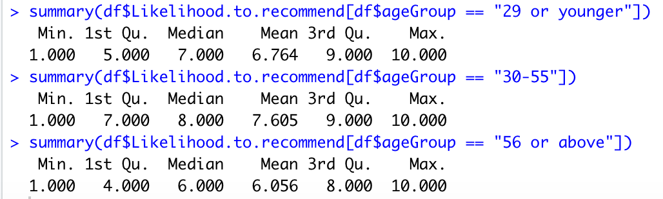
Age Groups vs Likelihood to Recommend
Notes:
First, we generated a boxplot to investigate the the raw data. From here, we can tell that the median grade for age group 30 -55 years old is actually higher than any other groups. The age group from 56 or above is indeed giving lower average grade.
To further verify this, we were sampling from each group and take average of the grades. We repeat this process 200 times and then we generate the histogram for different age group. And now, the median of each histogram should reveal the true mean of the group. The median score for young age group is 6.8, median age group is 7.7 and old age group is 6.2. Hence, we can say that the people in the median age group tends to give a higher score whereas the people from the older age group tends to give a lower score.

Slide 8
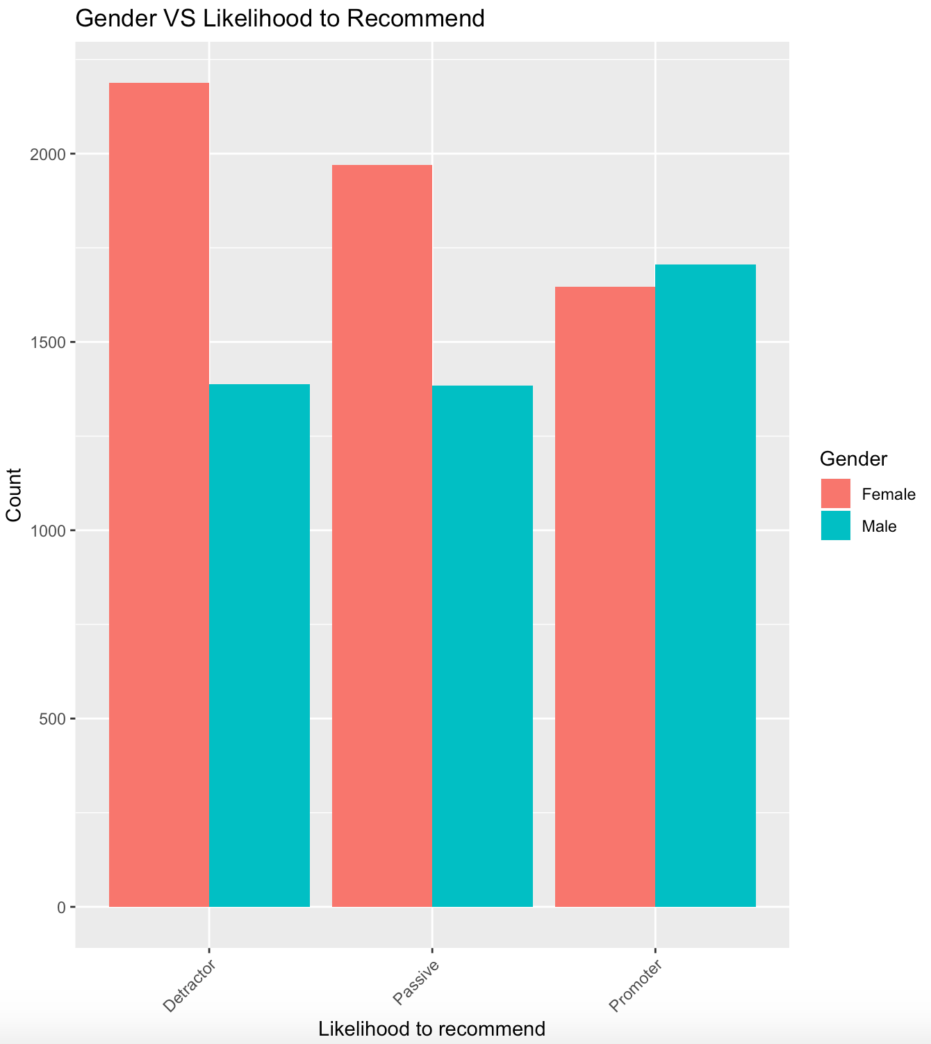
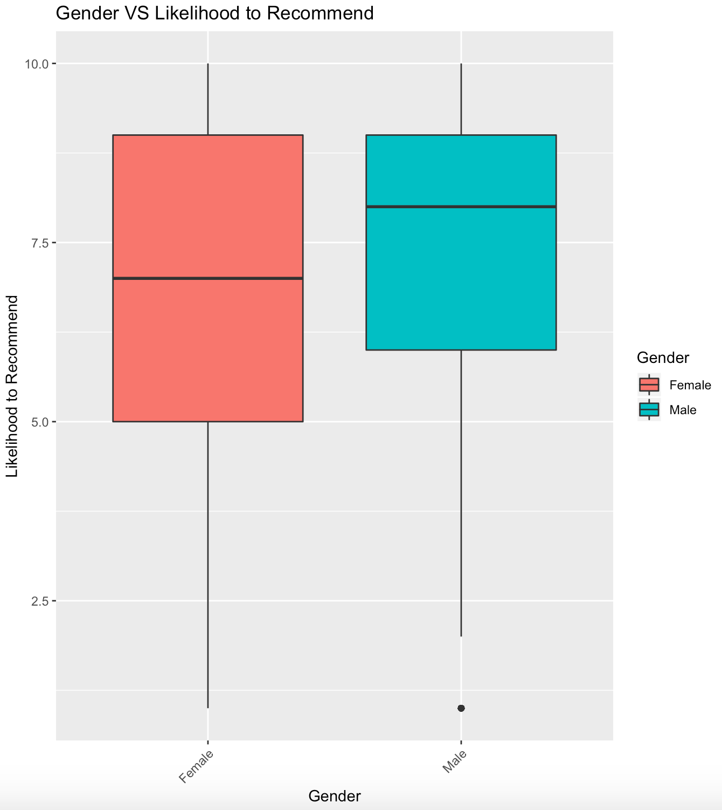
Gender VS Likelihood To recommend
Notes:
First, we have investigated the population in both group. The female has 5804 people, male has 4478 people. From the graph at the left, we see that females are more likely to be a detractor or passive. Males are more likely to be a promoter even though the population for Female is larger than Male. By looking at the picture at the right, which is boxplot. The median score for males are higher than females.

Slide 9
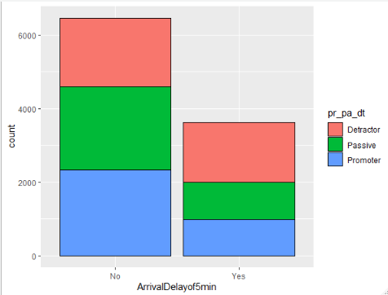
Effect Of Arrival Delay on Likelihood to Recommend
Notes:
Does the arrival delay affect likelihood to recommend? First, for those flights delayed over 5 minutes, we say they are delayed. Otherwise, they are not. From the graph, we can easily see that the delayed flights are having more detractors and those are not delayed would more likely to have more promoters.

Slide 10
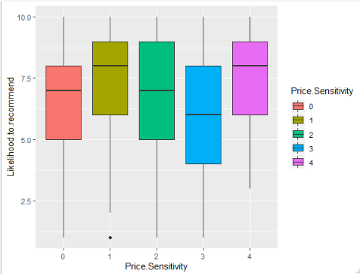
Price Sensitivity w.r.t likelihood to recommend
Notes:
It is a boxplot for the people have different price sensitivity. It seems like people having sensitivity level of 1 and 4 would more likely to give higher chance to recommend because they are having higher median score, third quantile and lower first quantile.

Slide 11
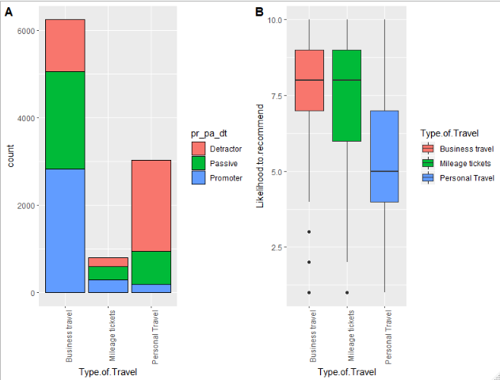
Type Of travel w.r.t Likelihood to recommend
Notes:
Does travel type affect the likelihood to recommend? The answer is yes! Business travelers are more likely to become a promoter and less likely to become a detractor. However, the personal travelers are extreme likely to become a detractor and very unlikely to become a promoter. By looking at the boxplot. Business travelers are giving much higher score than the personal travelers in general.

Slide 12
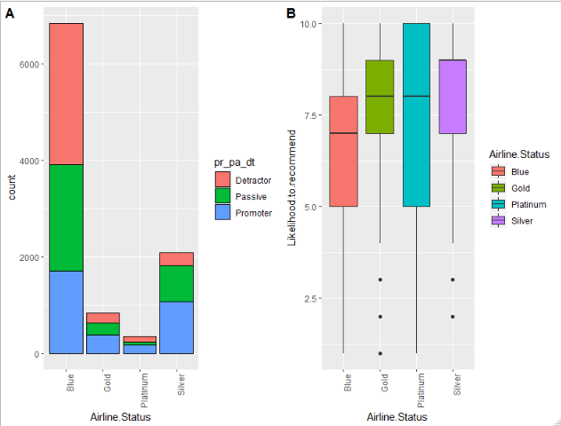
Airline status having max detractors

Slide 13
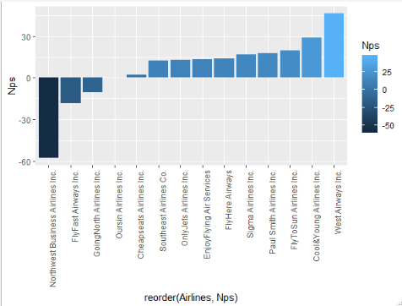
Nps score with respect to Partner Airlines

Slide 14
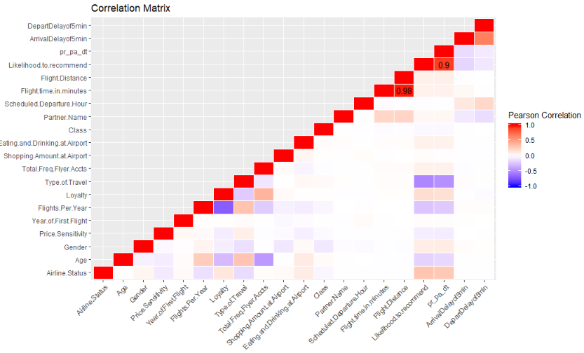

correlation matrix and Linear Model to select variable names

Slide 15
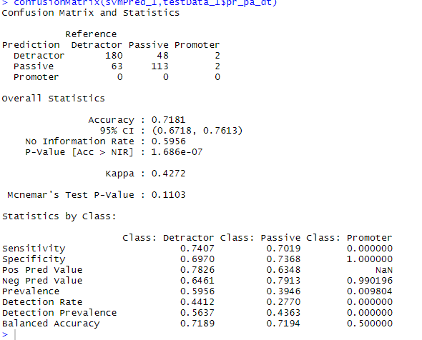
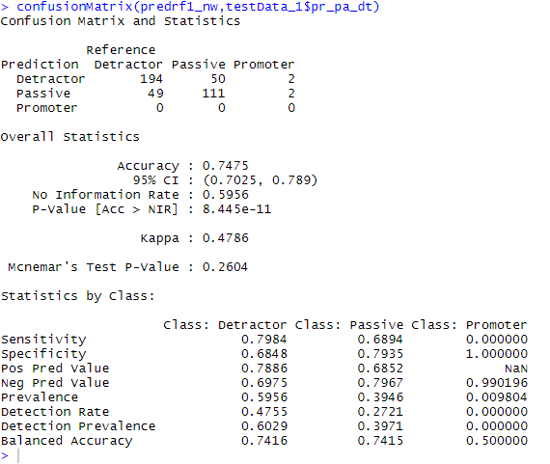
Models
Variable Names
Airline Status
Gender
Price Sensitivity
Flights Per Year
Loyalty
Type of Travel
Total Freq Flyer Accts
Eating and Drinking at Airport
Class
Origin State
Destination State
Flight Distance
Arrival Delay
Age Group
Likelihood to Recommend
SUPPORT VECTOR MACHINE
RANDOM FOREST

Slide 16
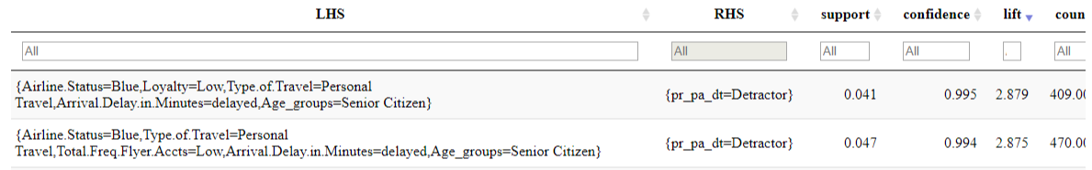
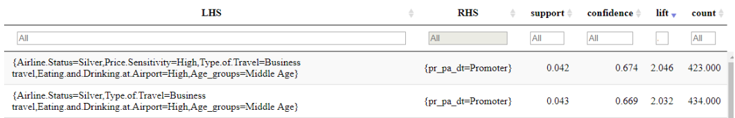
Inferences from the ENTIRE DATA SET

Slide 17
Data Driven Insights For improving Customer Satisfaction
The South East Airlines and their partners should focus on needs of the Female customers, by providing them with better services for example mothers travelling with their children should be provided special attention and their needs should be catered to, better seats can be provided (with better leg room) to them, their food preferences can be taken into consideration and more importantly start taking customer feedback etc..
Airlines belonging to the Silver, Gold and Platinum status achieve relatively higher positive ratings from the customers when compared with airlines in ‘Blue’ status.
So, the airlines in “Blue” status should attract the customers with some discount coupons and improving their services such as in-flight entertainment, better food options, so that the passengers feel that they are getting value for their money, as they tend to be price sensitive.
Airlines should focus on giving better amenities such as wheelchair services, better seats, assistance at the time of check-in and express boarding to customers who are above 54 years as they are more likely to be detractors.
Airlines who have passengers travelling for business purposes should focus that the flight is running on time as if the flight is delayed there is a high probability that they might give a negative rating so passengers should be provided with lounge access and if the passenger misses his connecting flight provide them with the next immediate flight.
Airlines should focus on passengers who are frequent flyers and price sensitive by enrolling them in a higher tier of their frequent flyer account so that they can accrue more mileage points and get free tickets, so in this way they can attract customers who are frequent flyers.
South East airlines should particularly focus on its regional partners Northwest Business Airlines Inc. and Flyfast Airways as they have the highest relative percentage of its passengers as detractors. We suggest that they should be put on a probationary tenure and be told to focus on the parameters suggested above to improve their customer ratings. If they fail then their contracts shouldn’t be renewed

